Slide 1
Software Re-Engineering
Lecture No.05
BSSE – 7 & 8
Instructor: Muhammad Usman Shahid

Slide 2
Lecture 5: Content
Evolution And Maintenance Models

Slide 3
Software Maintenance Life Cycle (SMLC)
software maintenance should have its own software maintenance life cycle (SMLC) model as it involves many unique activities.
Focus on product enhancement and correction,
The software product which is released to a customer is in the form of executable code, whereas the corresponding “product” within the supplier organization is source code
Source code can be modified without affecting the executable version in use.

Slide 4
Software Maintenance Life Cycle (SMLC)
In addition, documentation associated with the system must be compatible, otherwise the customer may not be able to understand the system.
Therefore, tight documentation control is necessary. In other words, the set of products that are released to the customer must be controlled.

Slide 5
Reuse-oriented Model
One obtains a new version of an old system by modifying one or several components of the old system and possibly adding new components.
Therefore, the new system is likely to reuse many components of the old system.

Slide 6
Reuse-oriented Model
A new version of the system can be created after the maintenance activities are implemented on some of the old system’s components.

Slide 7
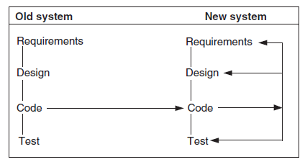
Reuse-oriented Model
Three process models for maintenance
1) Quick fix model. In this model, necessary changes are quickly made to the code and then to the accompanying documentation

Slide 8
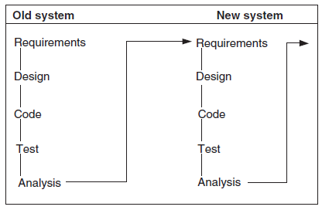
Reuse-oriented Model
Three process models for maintenance
2) Iterative enhancement model. In this model, first changes are made to the highest-level documents.
Eventually, changes are propagated down to the code level.

Slide 9
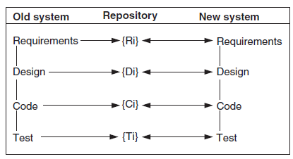
Reuse-oriented Model
Three process models for maintenance
3) Full reuse model. In this model, a new system is built from components of the old system and others available in the repository.

Slide 10
The Staged Model For Closed Source Software
comprises a sequence of five stages:
1) Initial development. Develop the first functioning version of the software.
2) Evolution. The developers improve the functionalities and capabilities of the software to meet the needs and expectations of the customer.
3) Servicing. The developers only fix minor and emergency defects, and no major functionality is included.

Slide 11
The Staged Model For Closed Source Software
comprises a sequence of five stages:
4) Phaseout. During this stage, the supplier may decide to not perform any more servicing.
The software may still be in use, but because change requests (CRs) are no longer honored, it is becoming increasingly outdated.
The users must work around the known deficiencies of the system more often.
Going back to an earlier servicing stage becomes very difficult because of the increasingly large number of CRs.
Eventually, the software system becomes a legacy system application.

Slide 12
The Staged Model For Closed Source Software
5) Closedown. The software is withdrawn from the market, and customers are directed to migrate to a replacement.

